Slide 1
Biquad_stages validation
K Sawmiller 2018

Slide 2
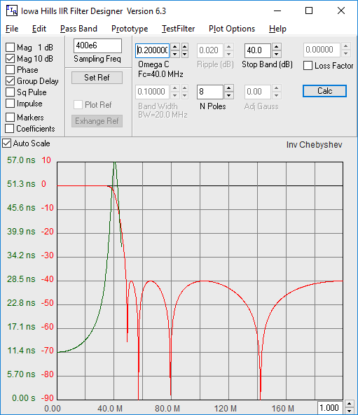
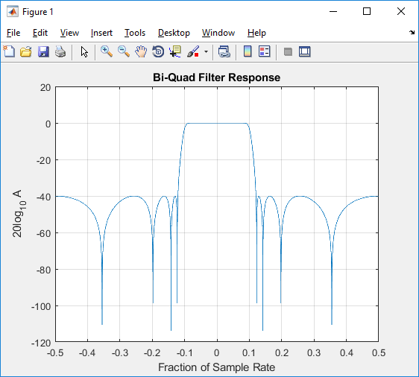
Test Filter
Fs = 400MHz
Actual Baseband Bandwidth = 80MHz
-Fs/2
0
Fs/2
Matlab output (plot)

